Slide 1
PAW pipeline for processing Proteome Discoverer TMT data
Phil Wilmarth, OHSU 2017

Slide 2
What does Proteome Discoverer (PD) do OK?
SEQUEST search engine is very good
Percolator PSM validation is okay
Reporter ion signals probably processed correctly
Results can be exported for alternative processing

Slide 3
What does PD do less well?
Use of signal-to-noise ratios for reporter ions (default)
Default minimum peptide length of 6 (7 is better)
Opaque protein inference (minimum and maximum parsimony?)
Inclusion of single peptide per protein IDs (default)
Un-validated protein ranking functions
Treatment of shared peptides (razor peptides)
Study design and statistical analyses (ratio based)
Typical workflows are complicated and difficult to configure (too many irrelevant options)

Slide 4
What does the PAW pipeline do well?
https://link.springer.com/article/10.1007/s12177-009-9042-6
A “best practices” pipeline
Not a ”black box” design
Transparent protein inference
Practical protein grouping
Correct processing and normalization of TMT data

Slide 5
Overall strategy
Use simpler work flows in PD and export the data
Convert PD PSM export files into PAW text files (with reporter ion quantities)
Apply robust protein inference and protein grouping
Compute protein-level total reporter ion intensities from unique peptides
Correct for sample loading differences
Use internal reference scaling (IRS) method for extended multiplexing

Slide 6
Computer requirements
Python 3.6
Requires numpy, pandas, and SciPy
Easiest strategy is to use the Anaconda scientific python distribution
https://www.anaconda.com/distribution/
Windows and Mac support
Local copies of PAW python scripts

Slide 7
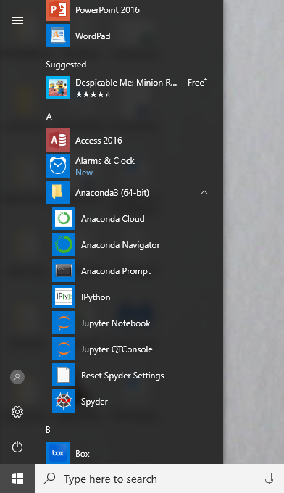
I like the IDLE development environment that is part of the standard python distribution. Anaconda prefers Navigator so running IDLE is more difficult.
Launching the Anaconda Prompt command window is an easy way to have some environmental variables defined, including the path where IDLE is located. Running the command window as an Administrator is not required but can be handy.

Slide 8
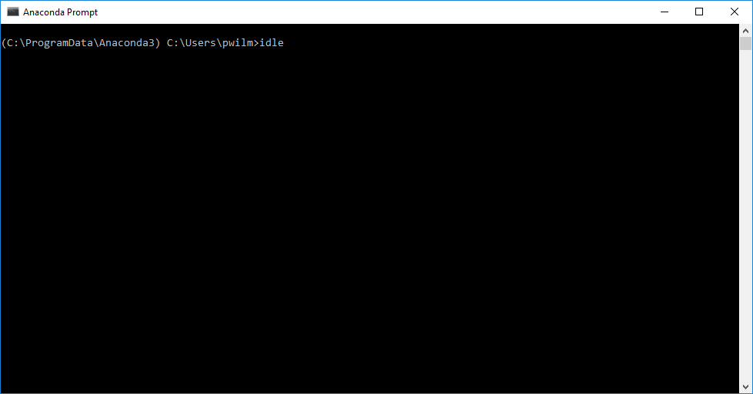
At the prompt, enter the “idle” command

Slide 9
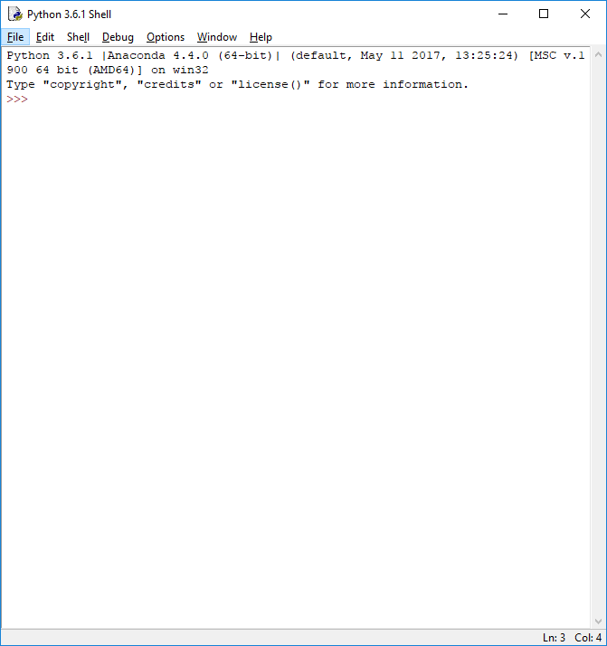
A console window will appear. The python version should be similar to the right. The “>>>” prompt indicates that the python interpreter is running and python statements can be entered.
Use the File menu Open command to open the first python script:
“make_PAW_TXT_from_PD2.x.py”
from the location where the PAW scripts are located on your computer.

Slide 10
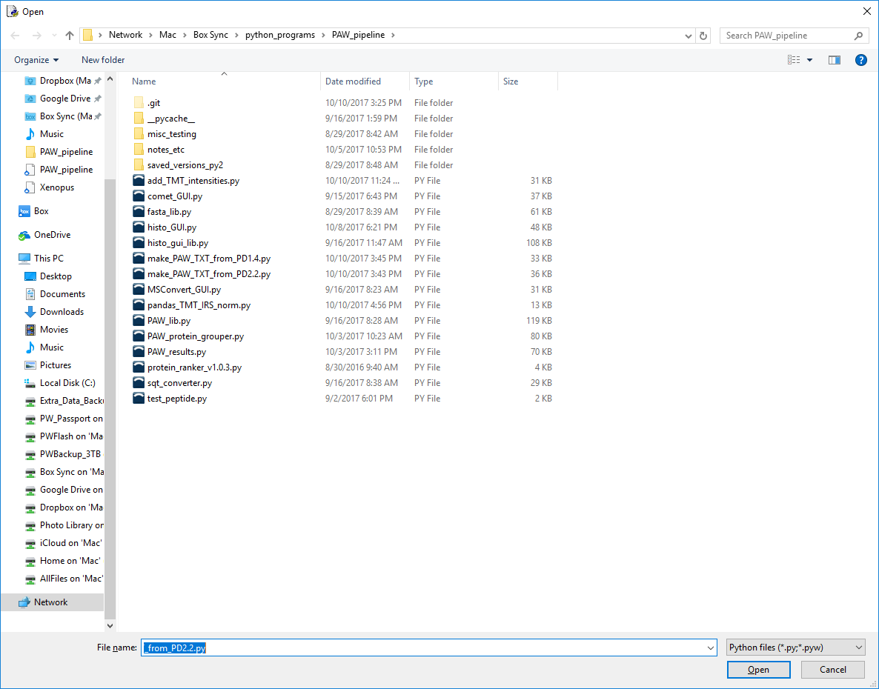
Select the converter for the appropriate Proteome Discoverer version (1.4 versus 2.1 or 2.2).
The PSM file should have already been exported from PD as a text file (tab-delimited). Regular headers or R-friendly headers are supported. Excel files are not supported.

Slide 11
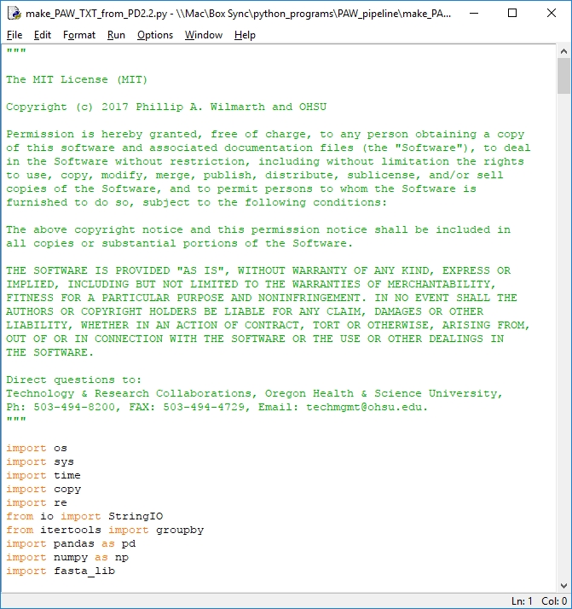
The script opens in a text editor window. Python is an easier computer language to learn than most. The scripts are fairly well commented and most variable names are sensible. Python scripts are somewhat upside down. Definitions of classes, functions (subroutines), and any global-scope variables need to have been scanned by the interpreter before it gets to the actual code. That usually means that they are located at the top of the text files.

Slide 12
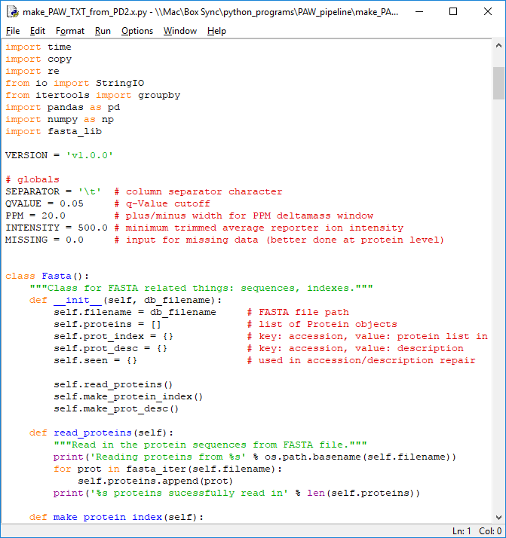
There are some global parameters located just below the “import” statements. There is a Percolator q-value cutoff (accepts PSMs with a smaller q-value than cutoff), a delta mass window in ppm, a minimum (trimmed) average reporter ion value (peak heights, a.k.a. “intensities” in PD are recommended and these are much larger numbers than the default signal-to-noise ratios), and a missing intensity replacement value (zero is better at this stage in the processing).
You might want a stricter q-value cutoff or tighter mass tolerances. If using S/N quantities instead of peak heights, the INTENSITY cutoff should be much smaller.

Slide 13
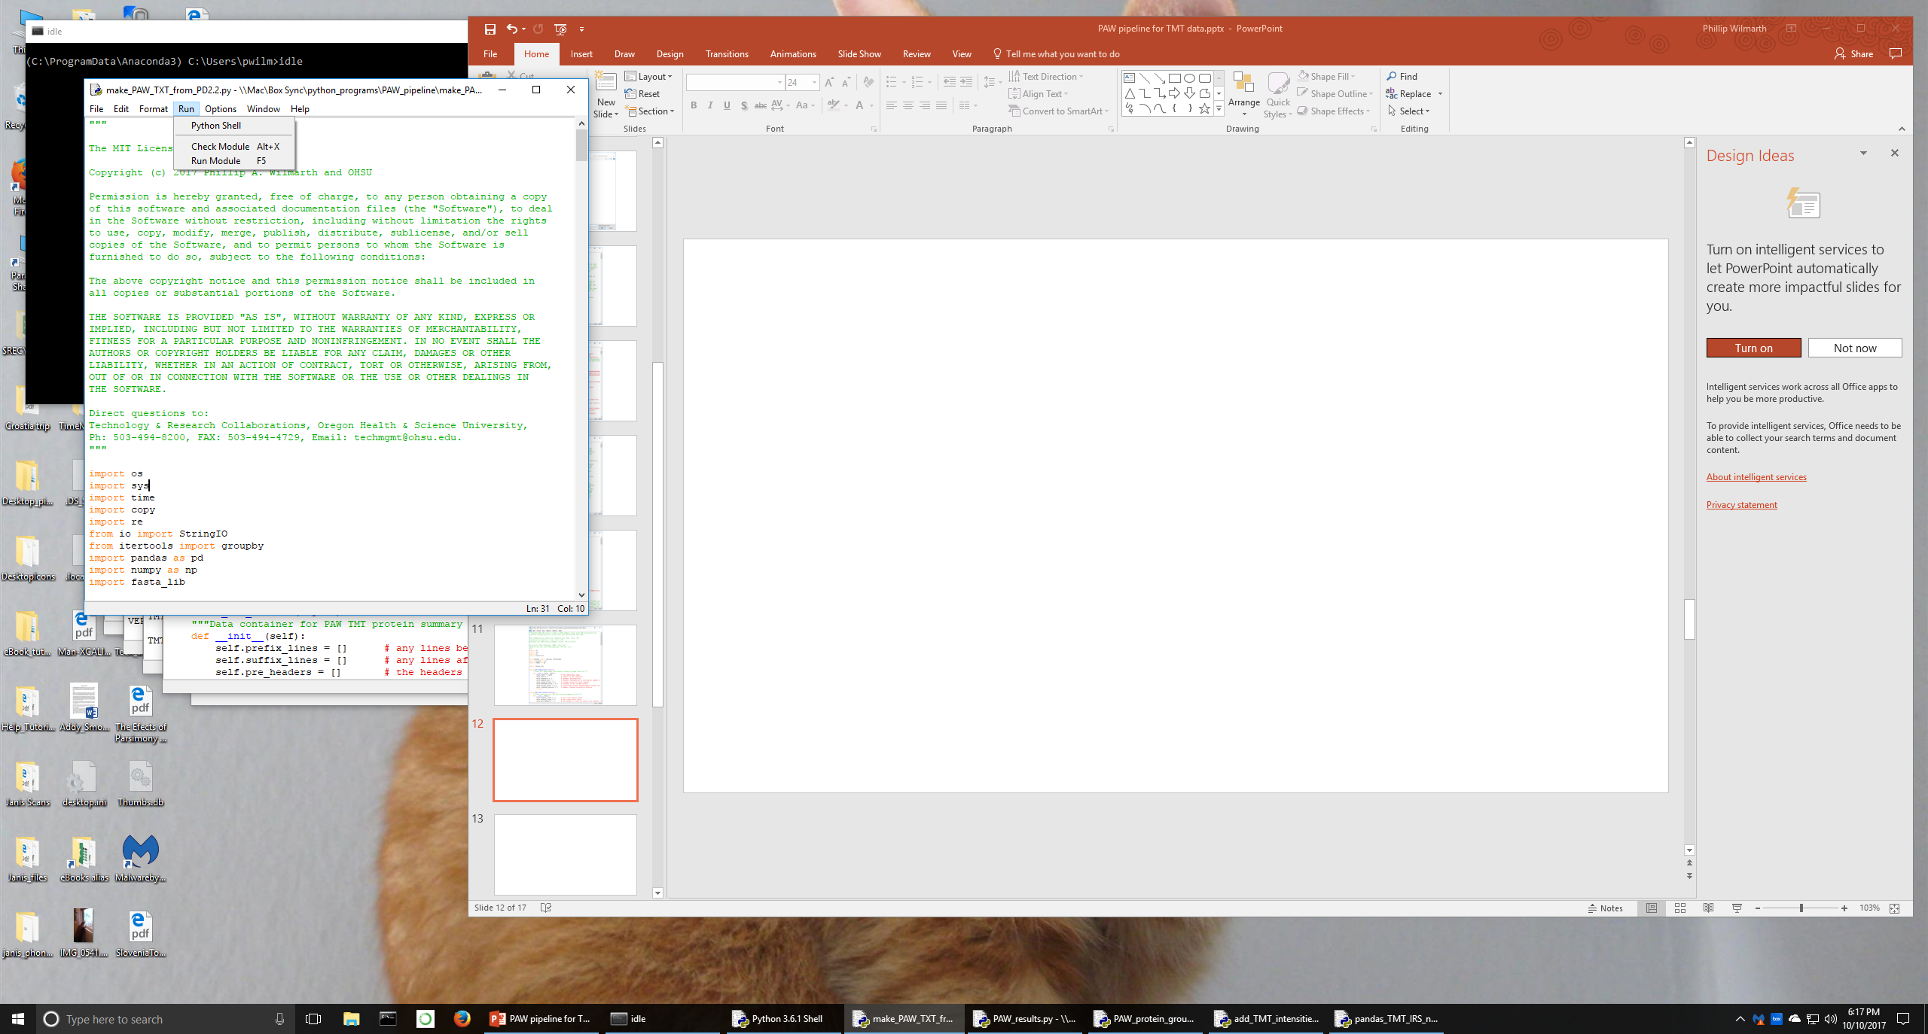
Select the Run Module command from the Run menu in the script’s text editor window to execute the script.

Slide 14
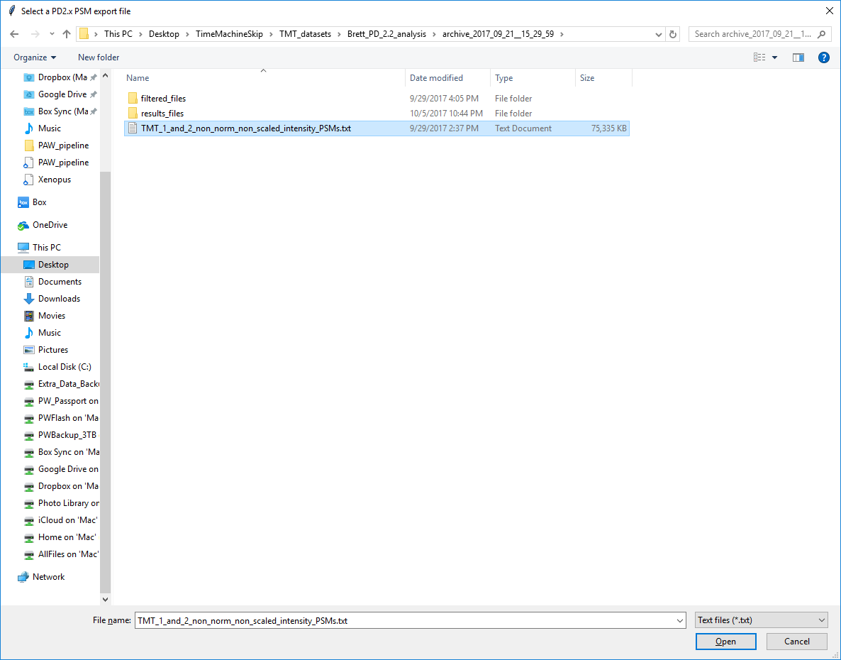
helpful message
1
All scripts get input filenames from user selections in standard file browser dialog boxes. This is an interactive pipeline, not a command-line pipeline.
2

Slide 15
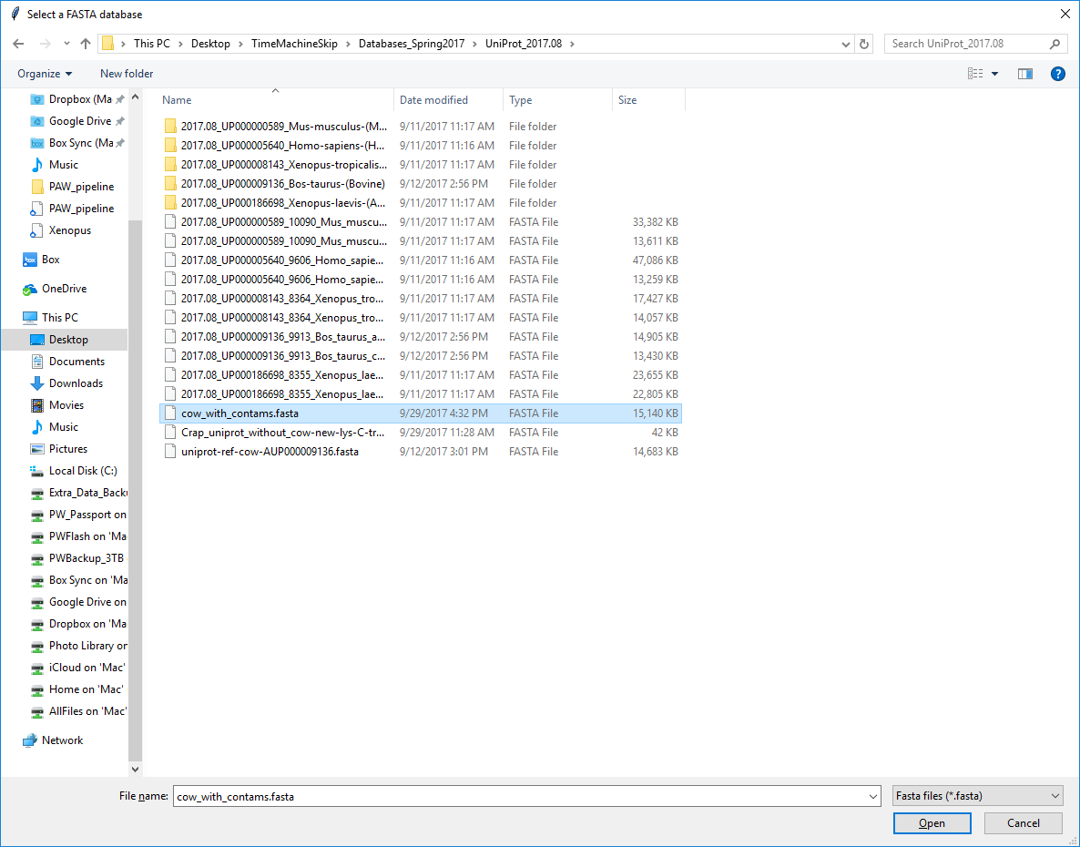
PD parses protein database accessions by default. The PAW pipeline needs to access the protein sequences and the FASTA file used in the search must be specified. The same FASTA file that was loaded into PD needs to be used (its name can be different). If multiple databases were used in the PD workflow, those databases need to be concatenated into a single FASTA file. All protein accessions in the PSM export file need to be present in a single FASTA file.
1
2

Slide 16
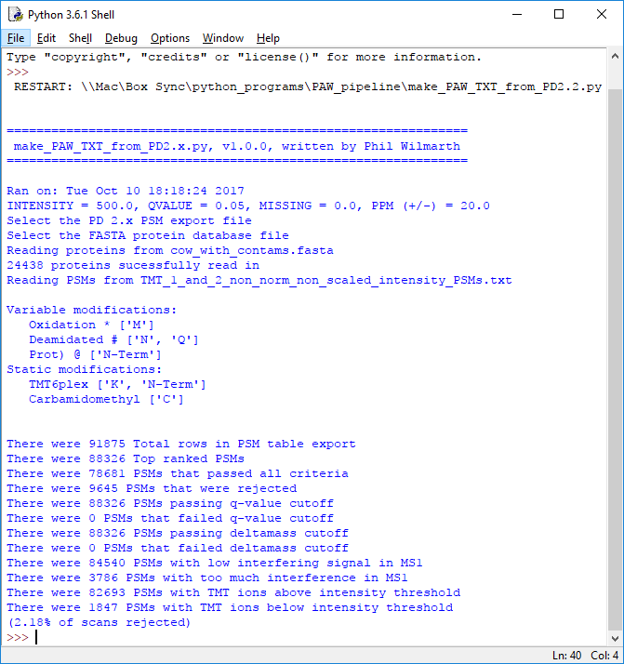
The script writes information to the console window as it runs. It echoes your parameter choices, the number of entries in the FASTA file, a summary of the modifications specified in the search (these are determined dynamically from the export file and should agree with the PD configuration), and then a series of PSM tallies subjected to the various filters. High scan rejection rates indicate problems with the data or parameter settings.

Slide 17
Background on SQT and TXT files used by the PAW pipeline: The pipeline was originally developed for SEQUEST search results (DTA and OUT files). Large datasets required more efficient file formats, and MS2 and SQT files are used. These are also used when processing Comet searches. PAW text files are simplified SQT files where only the top hits are retained. The data is in a more traditional table layout as well. “Filtered” versions of these files are just the scans that pass any score thresholds (usually some FDR cutoff). Removing low scoring, incorrect PSMs speeds up all downstream processing. Since PD has done the processing of the SEQUEST results and Percolator has computed q-values, the PSMs that pass any desired FDR cutoffs and accurate mass windows can be converted to these “filtered” TXT files. There are also parallel filtered SQT files that are created, which are dummy files so that the correct “txt” extension files can be determined. There is one TXT file for each LC run performed by the instrument. The TXT files contain the information needed for any subsequent pipeline steps. A PAW analysis can encompass more than one PD processing. Generally, PSM-level error control requires a reasonable sized dataset for statistical reasons. However, experiments run too far apart may best be analyzed separately by PD and the results combined after the PSMs have been exported. The PAW pipeline will combine all filtered TXT files present in a single folder and do protein inference using all of the data. The only requirement is that all of the data was searched against the same FASTA file, but the samples should have a reason to be combined. To combine more than one PD processing into a single results file, the filtered SQT and TXT files from each export have to be copied into a single folder and that single folder used for downstream PAW processing. Having the user do some file preparation before running the scripts is easier than programming support for files in multiple locations.

Slide 18
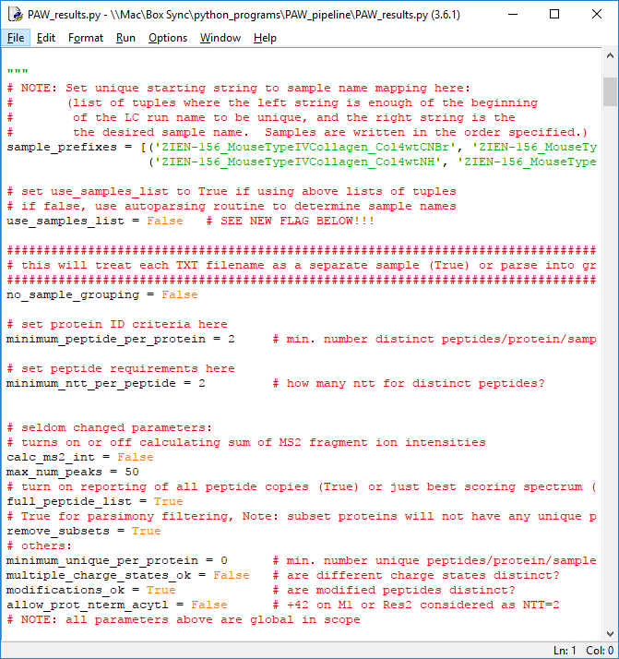
The next script to open and run is: PAW_results.py The LC run (RAW) file names will need to be mapped into sample names and there is a simple command line loop interface to do that interactively. There are two adjustable parameters that may need to changed for some types of analyses: the minimum number of peptides per protein setting and the minimum number of tryptic termini per peptide (fully tryptic). Note that single peptide per protein identifications are typically very noisy and NOT recommended. Semi- or non-tryptic searches are not common these days, so the parameters will probably not need to be changed in most cases.

Slide 19
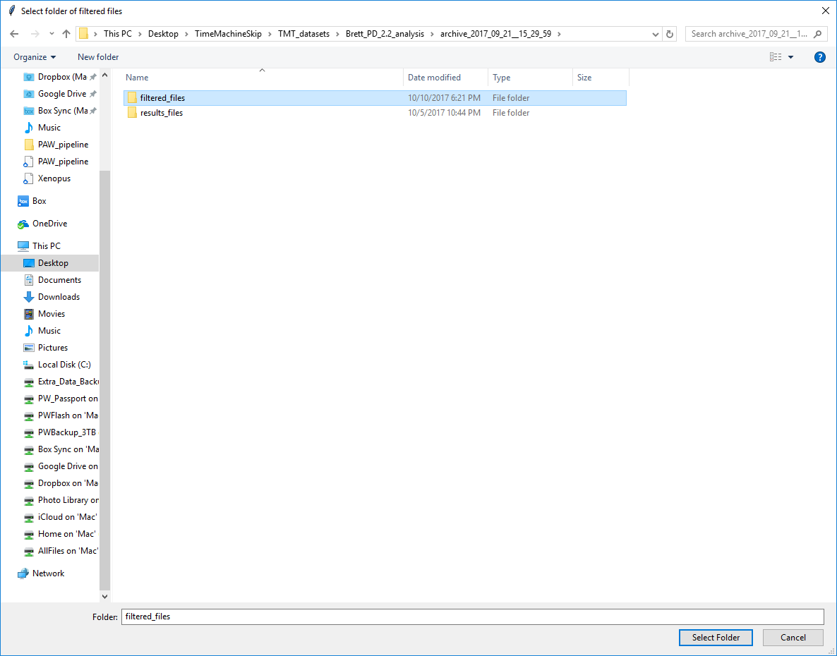
As discussed, all filtered files contained in the selected folder will be combined into a single results summary. A single list of all proteins having sufficient identification evidence for the samples will be generated (rows) and the identification evidence across the different biological samples will be shown in different columns in the reports. There is a protein-level report and additional peptide-level reports.
1
2

Slide 20
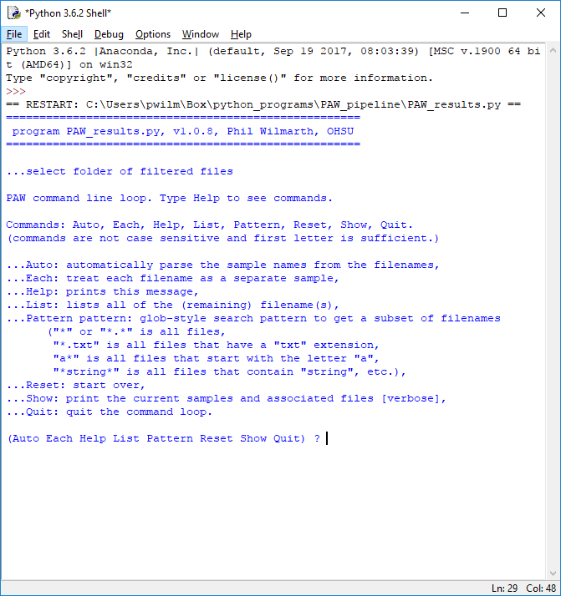
Upstream pipeline steps have not needed any knowledge of how the LC runs relate to the biological samples (or to the TMT experiment – a group of multiplexed biological samples). Inferring proteins from the PSMs does need this. Each PAW TXT file or SQT file corresponds to a single LC run (one RAW file). The mapping of many LC run names to one or more biological sample must be defined here. A simple command line loop has been implemented. Commands can be abbreviated to the first letter and they are not case sensitive. Help will display the commands and what they do. Auto attempts to automatically determine the sample mapping. Each makes each LC run into a separate sample name. Pattern allows wildcard searching to identify subsets of the LC runs and assign them sample names. When all LC runs have been assigned sample names (the List command displays no LC runs), Quit exits the command loop and starts the protein inference.

Slide 21
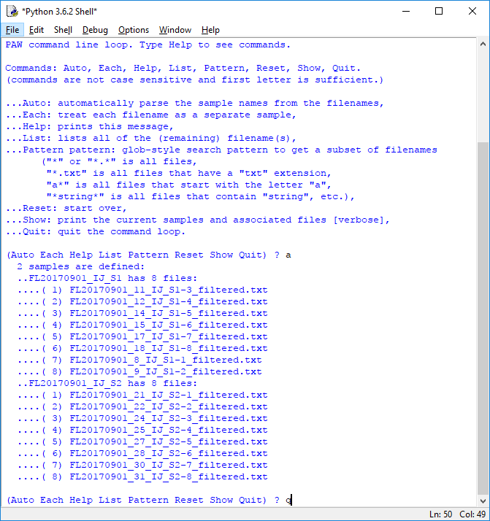
Using the Auto command is a good place to start. The parsing assumes small numbers are likely fraction designations and that text strings are more likely sample designations. It will Show the sample mapping. If it is acceptable, type Quit to start the protein inference. If it did not produce a correct result, then Reset the mapping and use the Pattern command to start grouping LC names into their respective sample names.

Slide 22
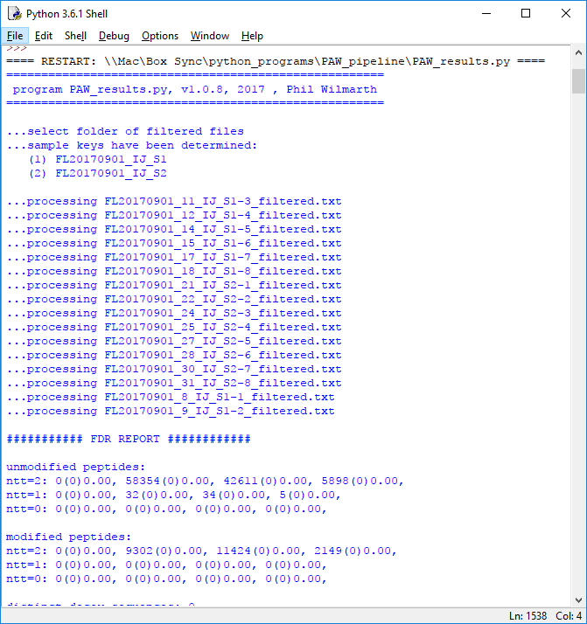
This script does the standard protein grouping and parsimony analysis. It produces extensive console output and writes a log file. Try and catch the automatic sample determination and make sure that it is correct. If it is not, you may have to edit the script’s “sample_prefixes” variable, change the “use_samples_list” flag, and re-run the script. The console window supports scrolling and can be resized.

Slide 23
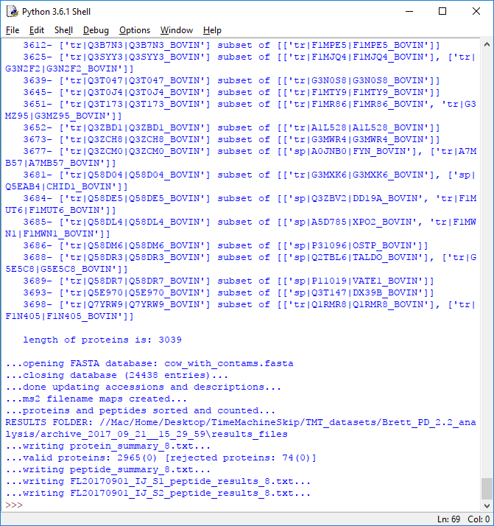
When the script finishes, it will tell you the final numbers of identified proteins and tell you which files it has written. The PAW pipeline does not retain any information about the removed subset proteins (some pipelines do) other than the console output and log file. The protein and peptide summary files are generically named. The more detailed peptide reports start with the biological sample names.

Slide 24
NOTE: This script now runs automatically after the protein inference (previous) step
Extended parsimony protein grouping: In higher eukaryotic organisms, there are many families of proteins that have many peptides in common (actins, tubulins, etc.). This is a problem in shotgun proteomics experiments, affecting both protein inference and in inferring protein-level quantification from peptide-level measurements. A detailed investigation of this topic can be found at http://digitalcommons.ohsu.edu/etd/3855/. It boils down to a simple fact: if a peptide maps to more than one “protein”, we do not know how to interpret its quantitative information. There are several contexts possible for deciding if a peptide is unique (only maps to one thing): with respect to the protein database (too strict), the list of inferred proteins (this is better), or a final list of proteins after grouping related protein family members (the best, depending on protein database choice and organism). The next (optional) step in the PAW pipeline is extended parsimony protein grouping where protein having “nearly” identical peptide sets are grouped as pseudo-redundant proteins, and proteins with peptide sets that are nearly complete subsets of proteins with larger peptide sets are removed. This grouping can make dramatic differences in the total protein intensities for highly abundant house keeping genes, for example.

Slide 25
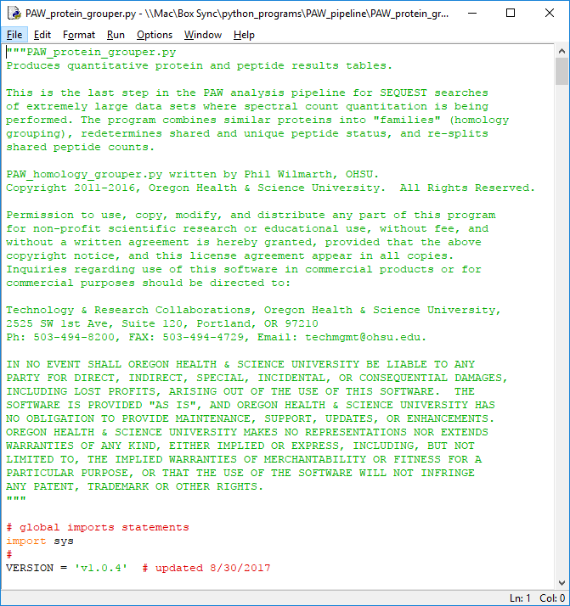
This script never needs to have its parameters changed. It creates some interesting console output and a companion log file. A new protein summary file and a new peptide summary file are created in response to the protein grouping.
Grouping may not be necessary for all proteomics experiments so the output from this script can be ignored in those cases (simple genomes or studies looking for isoforms).

Slide 26
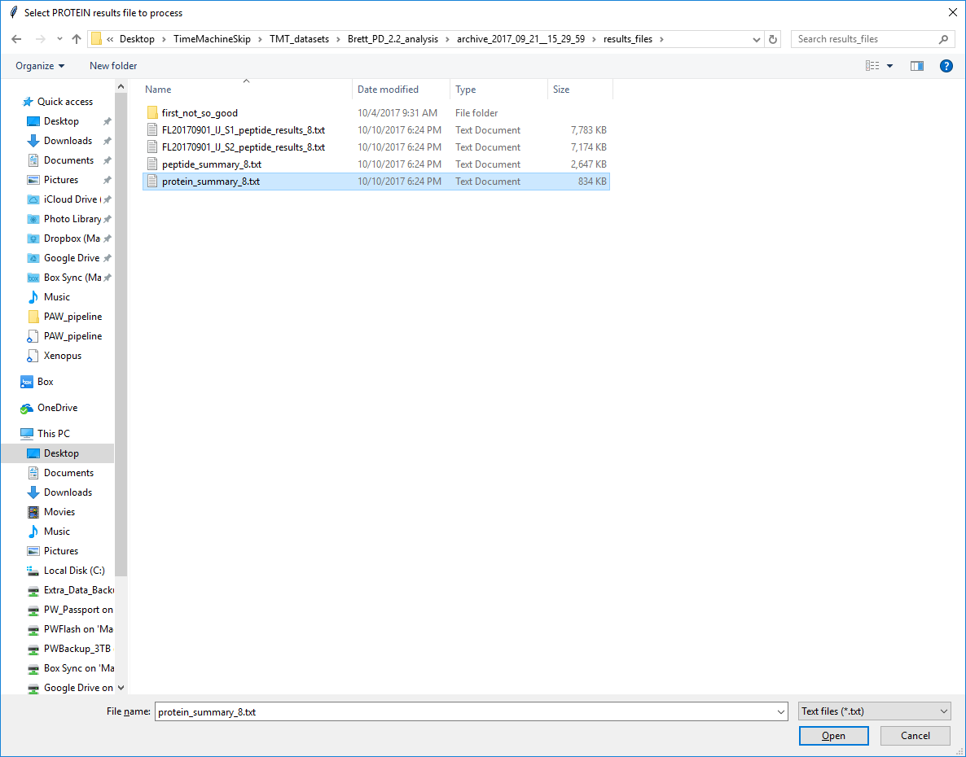
1
2

Slide 27
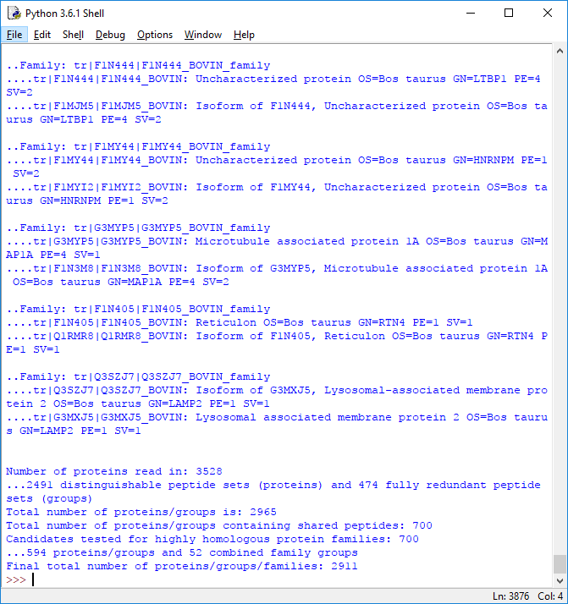
All proteins that are connected by any shared peptides are compared to each other. If the indistinguishable evidence (shared peptide count) overwhelms the distinguishable evidence (unique peptide count), then proteins are grouped together. Details of all of the pairwise comparisons are logged to console and disk, and the final summary data is displayed.
The regular protein summaries and the grouped summaries are somewhat complementary. Information about redundant protein group members is more explicit in the regular protein summary files.

Slide 28
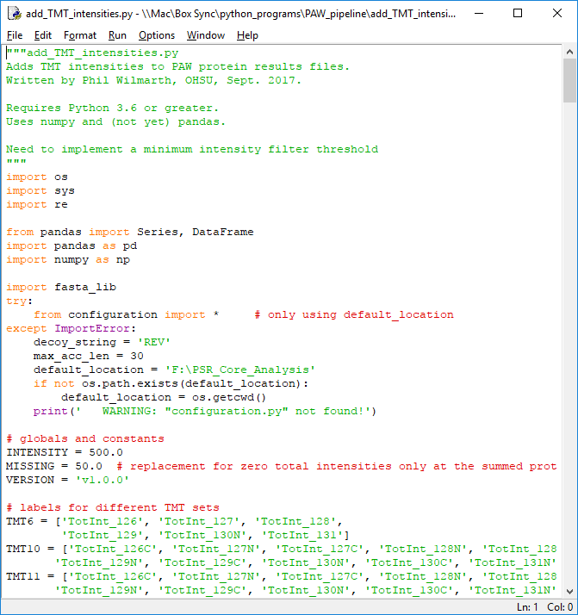
The protein inference step and the grouping step do not need to be aware of any quantitative data and they are the same scripts that have been used for many years (other than being updated for Python 3). A separate script uses the protein and peptide information in the summary files to combine the reporter ion peak heights (intensities) from the individual PSMs into peptide and protein-level summaries. Protein reports either before grouping or after grouping (recommended) can be selected.

Slide 29
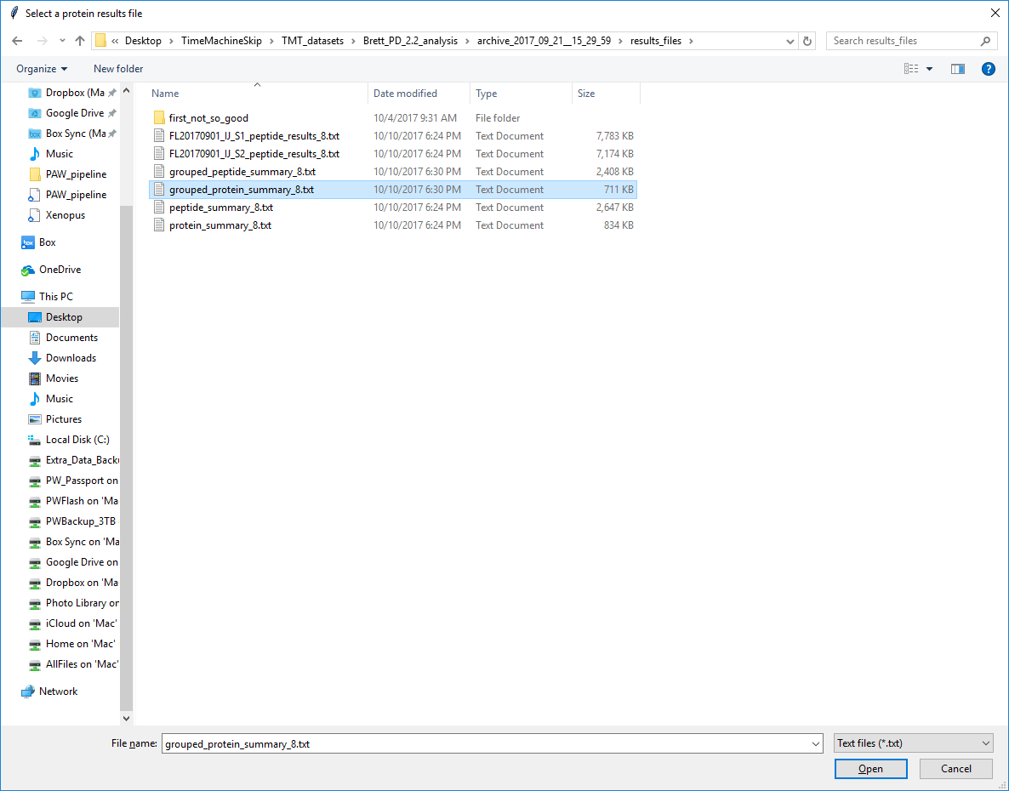
1
Can also pick the regular protein summaries
2

Slide 30
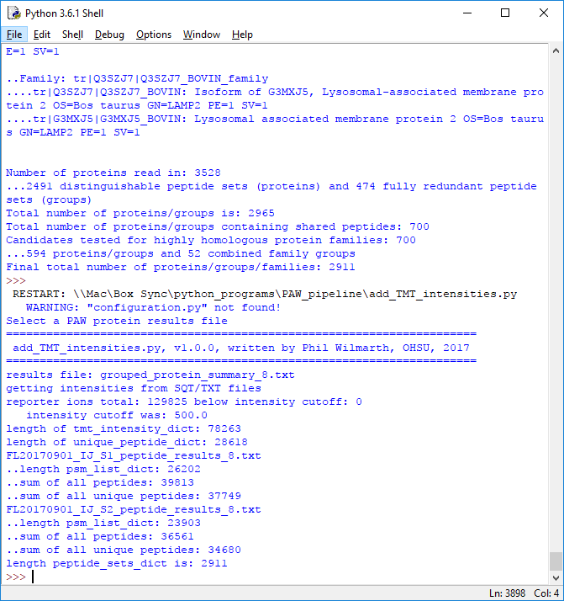
Console output is mostly the sizes of some internal data structures.
The output files are new protein and peptide summary files with additional columns that contain the TMT reporter ion intensities summed to the protein or peptide level, respectively.

Slide 31
Automated sample loading corrections and IRS corrections: Before statistical testing of the protein relative abundances can be done, some basic data normalizations are needed. Equal amounts of protein (digest) are supposedly labeled, but the sums of all PSM reporter ion intensities of non-contaminants for each TMT label are seldom equal. They can be adjusted in software to be equal.
Samples split across multiple TMT labelings in larger studies are more challenging. When the same samples (such as a pooled internal standard) are present in each TMT experiment, an internal reference scaling method* can be performed. This method corrects for random MS2 sampling.
Performing these steps are not hard to do in Excel; however, they are time consuming and error prone. To do the computations in Python requires that some experiment specific knowledge be communicated to the software. Which proteins are considered contaminants must be known for the sample loading corrections. Which specific channels are the common standards in each TMT set must be known for the IRS procedure. The easiest way to communicate this information to the script is to make some edits to the protein results file that the TMT intensities were added to (the previous PAW step).
An easy way to edit large tables is with Excel.
*Plubell, Deanna L., et al. "Extended Multiplexing of Tandem Mass Tags (TMT) Labeling Reveals Age and High Fat Diet Specific Proteome Changes in Mouse Epididymal Adipose Tissue." Molecular & Cellular Proteomics 16.5 (2017): 873-890.

Slide 32
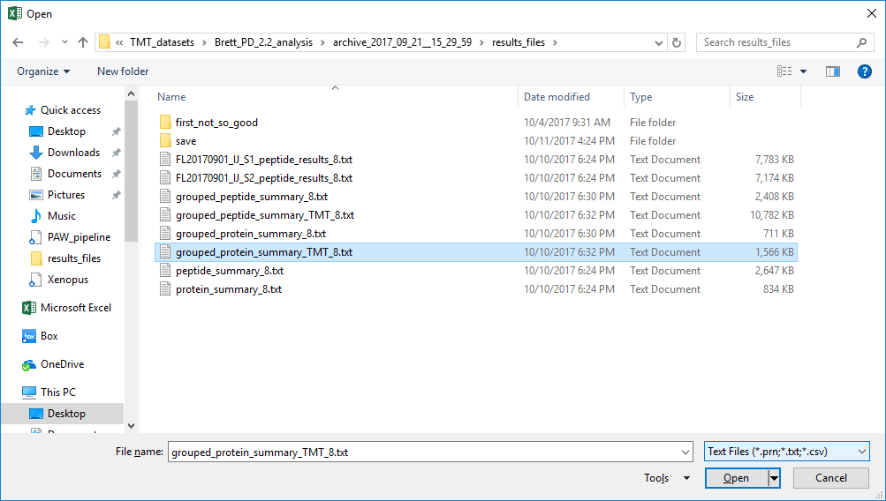
2
1
3
Open Excel then open the text file using the file browser, or right click on the text file and open with Excel.

Slide 33
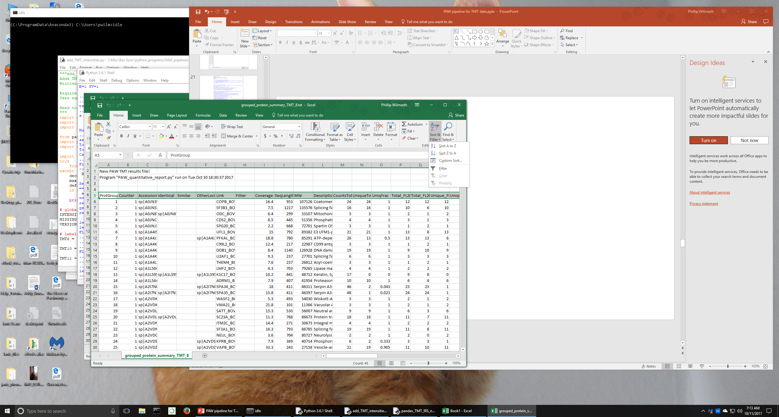
The table will open (the file extension and file type will be “.txt”). Select Row 5 (click on “5” in the left table margin), then turn on column filters.
Use Accession or Description column information to find contaminant proteins.
2
1

Slide 34
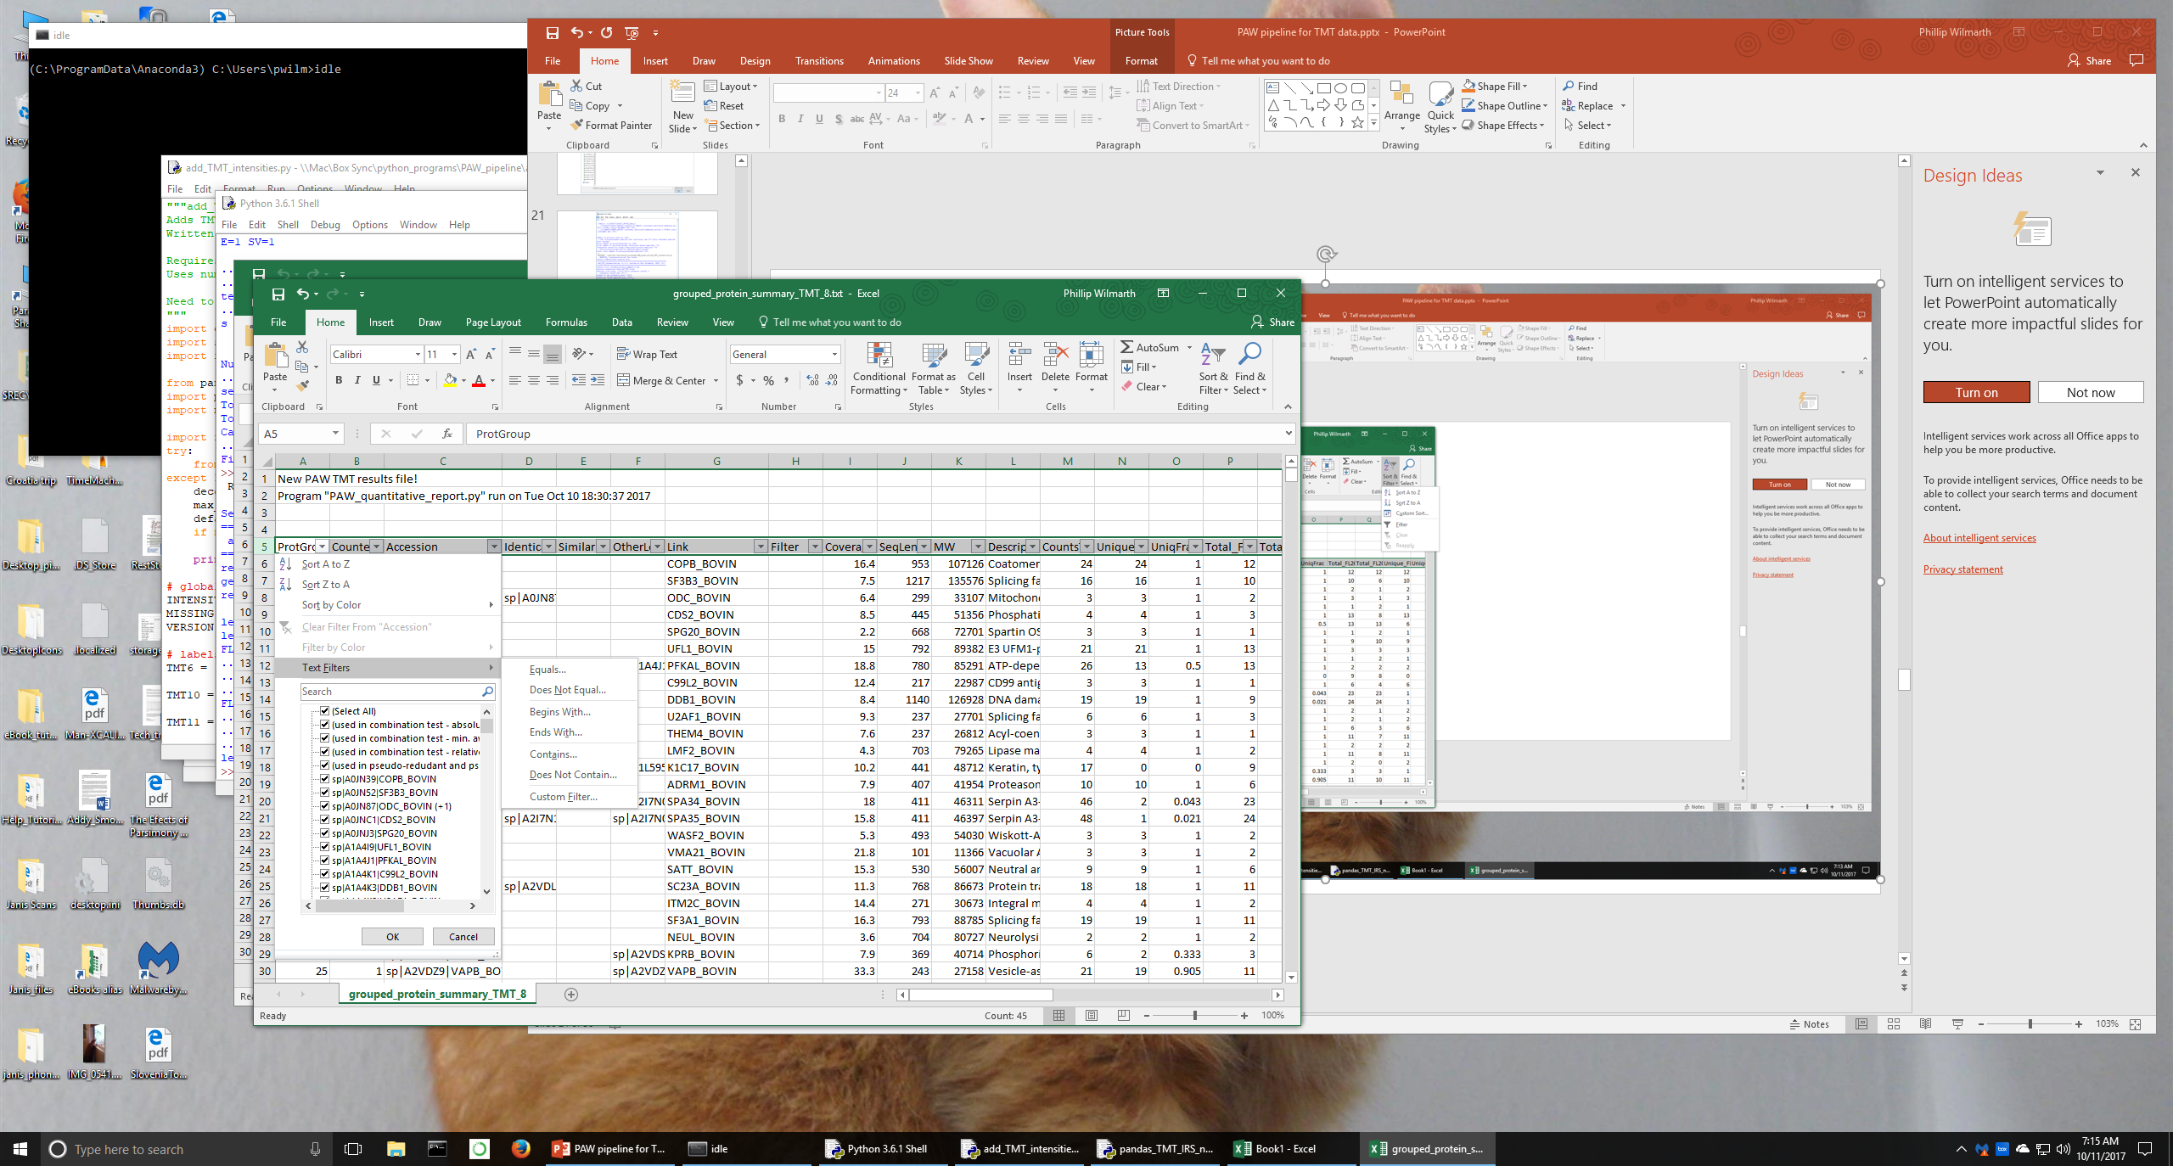
This dataset has non-bovine proteins from a contaminants database
We can highlight those by filtering for accessions that do not contain “_BOVIN”

Slide 35
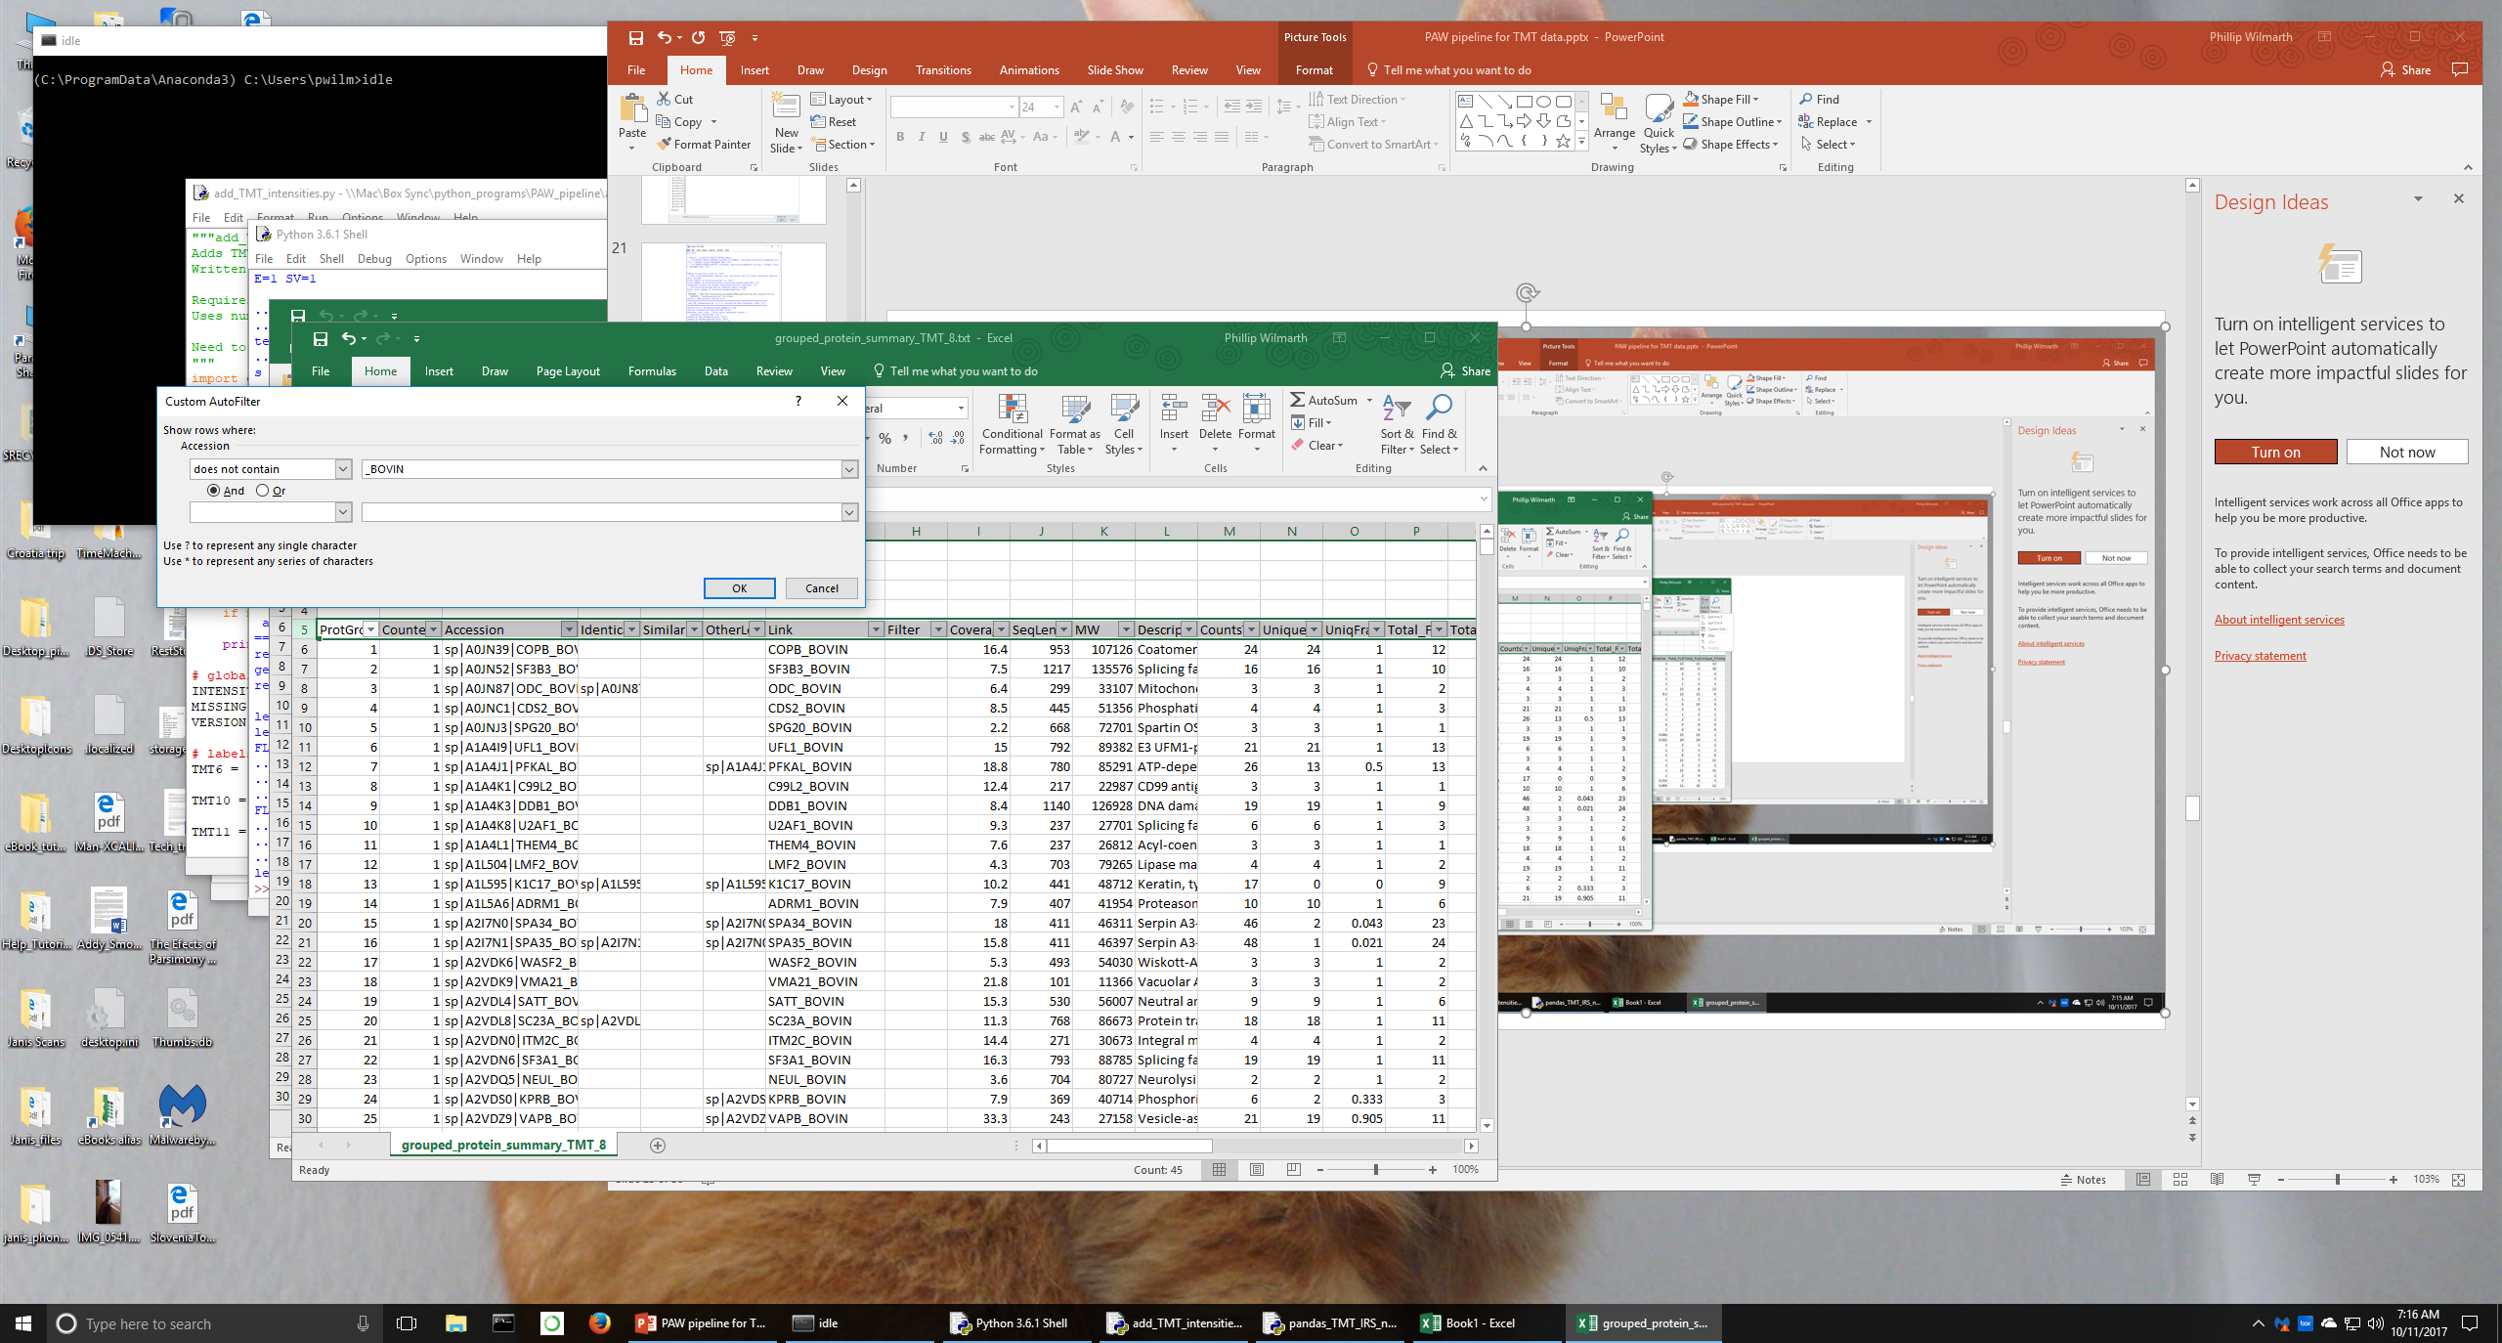

Slide 36
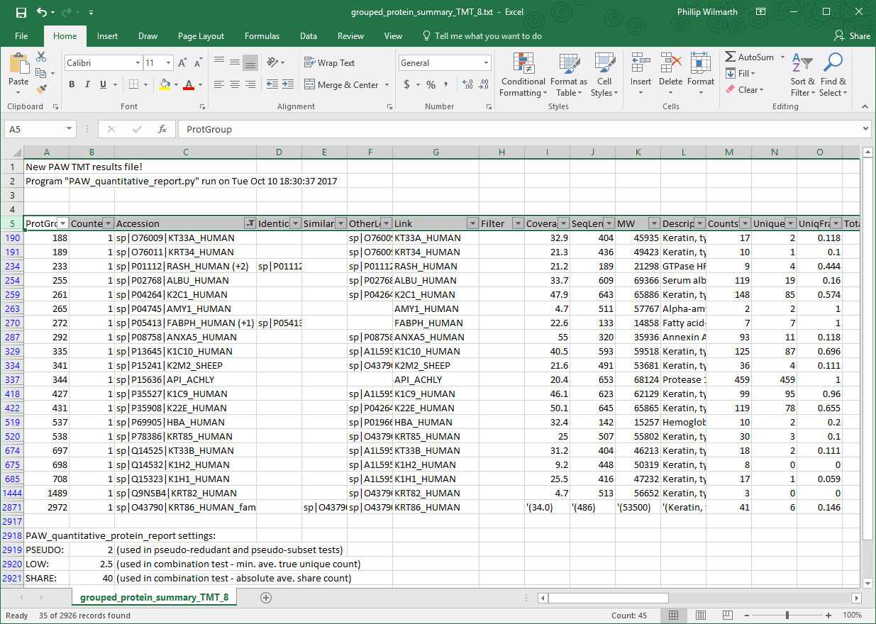
We now have a few rows of non-bovine contaminant proteins displayed.

Slide 37
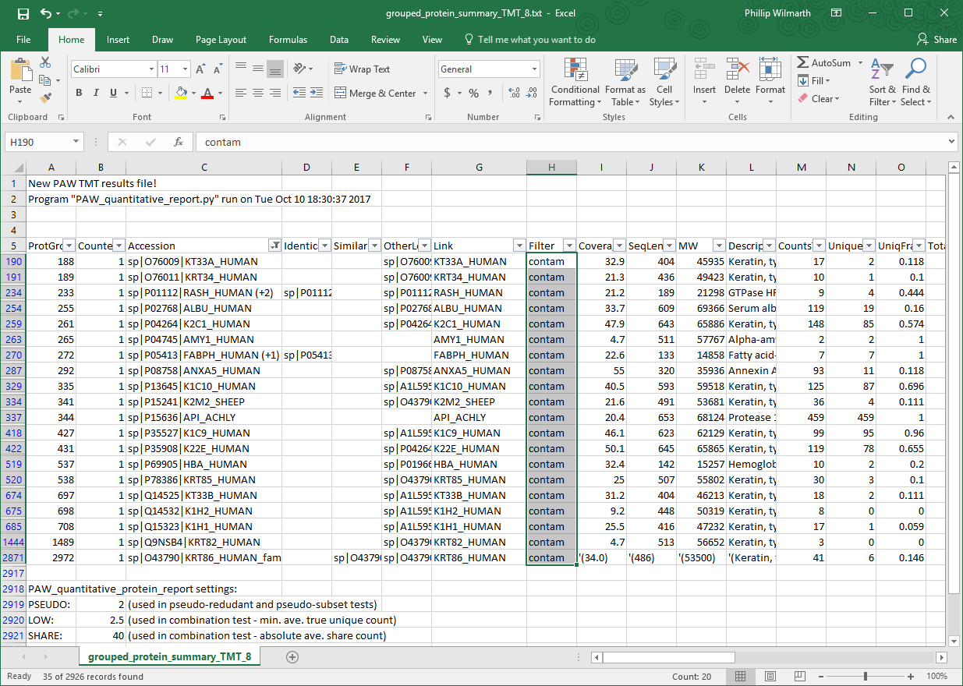
We add a text flag (contam) to the “Filter” column for these proteins.
There can be other bovine keratin sequences to exclude, and often albumin is a contaminant. Note that albumin is not a contaminant in blood (serum or plasma), CSF, urine, saliva, or some other secreted fluids. This is why automatically determining contaminants is not done.

Slide 38
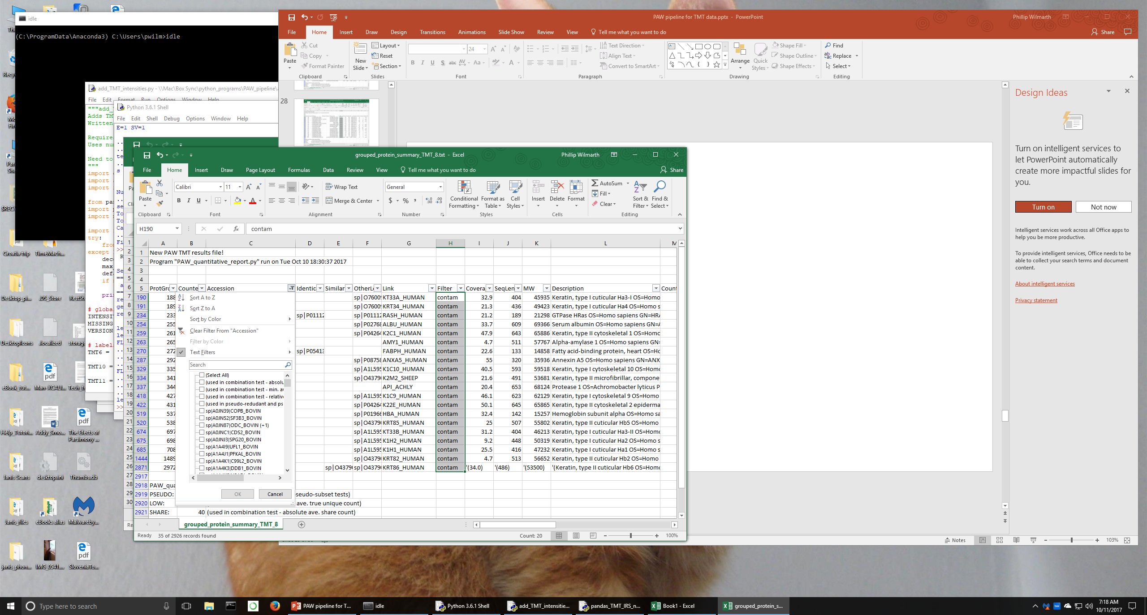
Remember to turn off column filters when you are done with them!

Slide 39
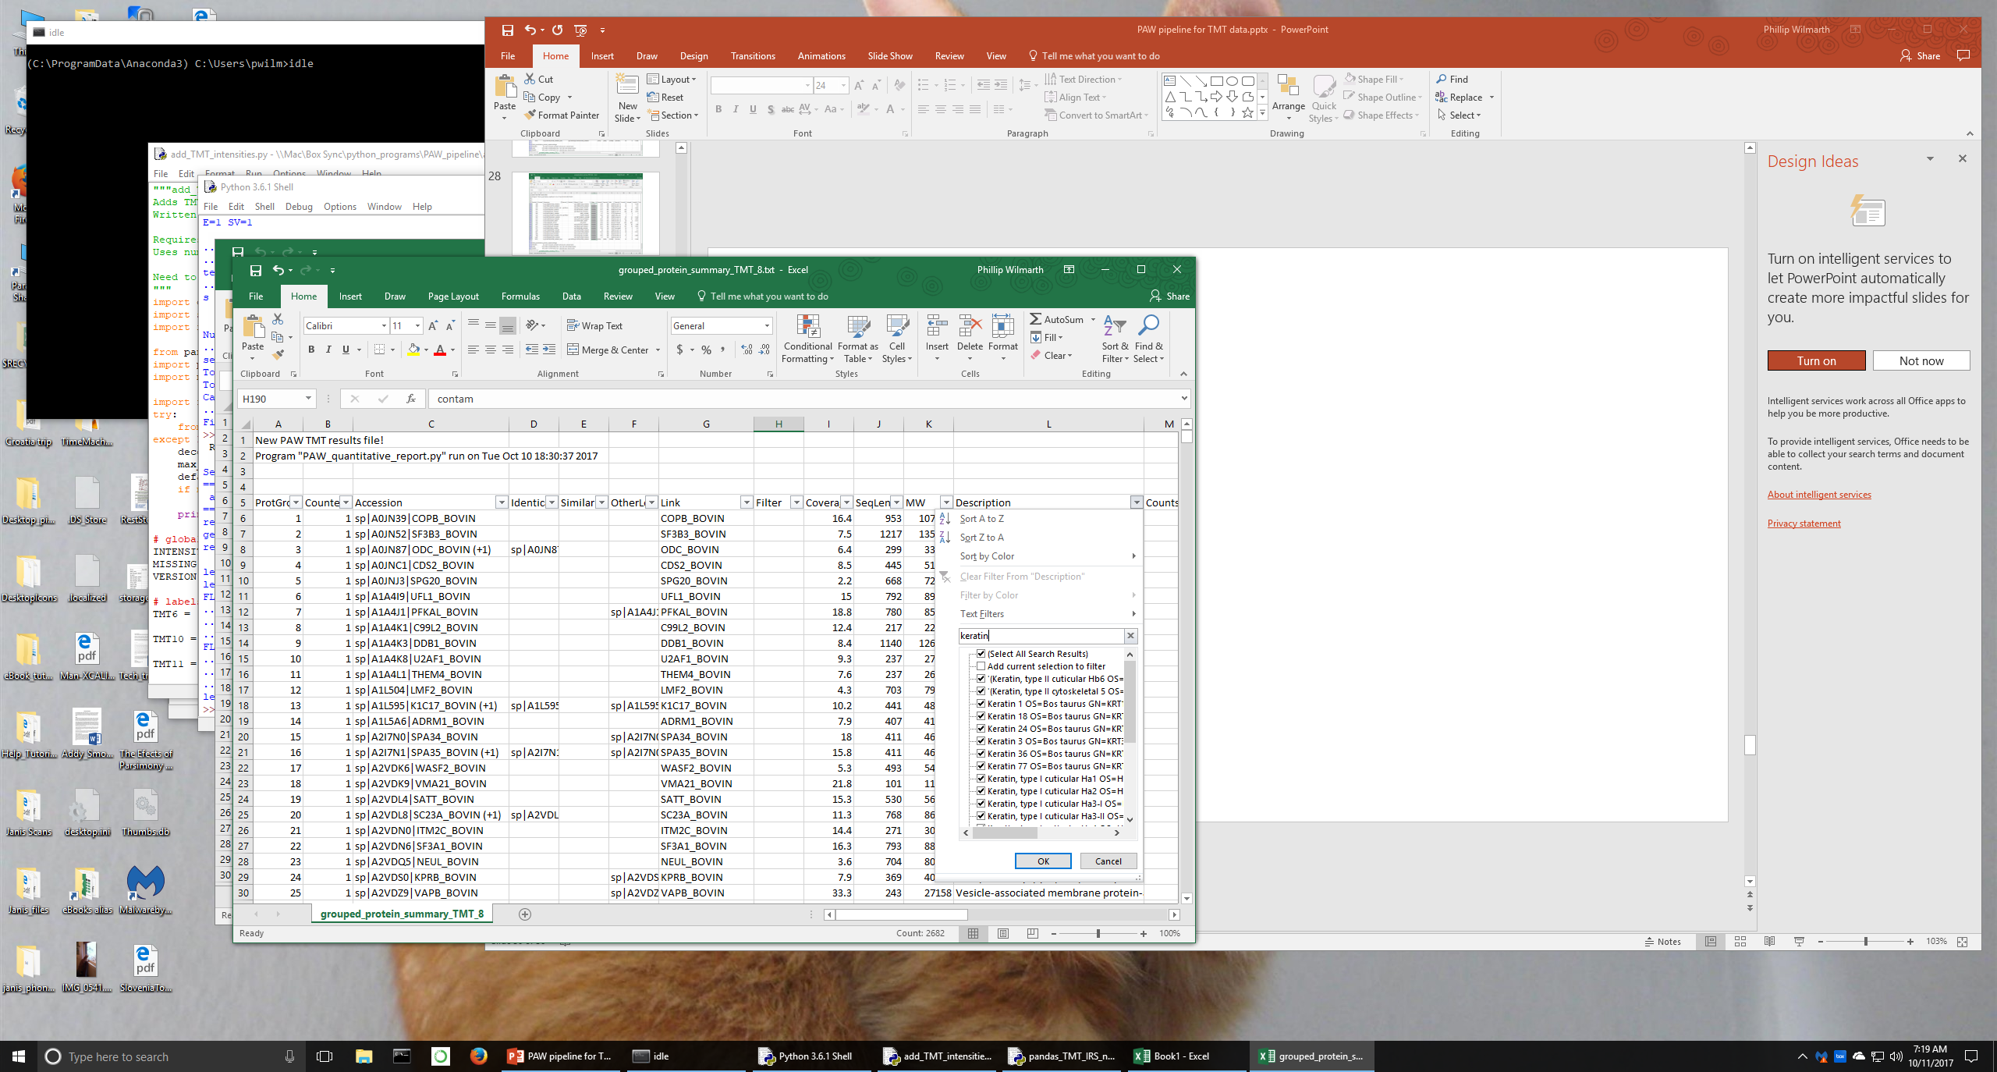
Let’s look for protein descriptions that contain “keratin”

Slide 40
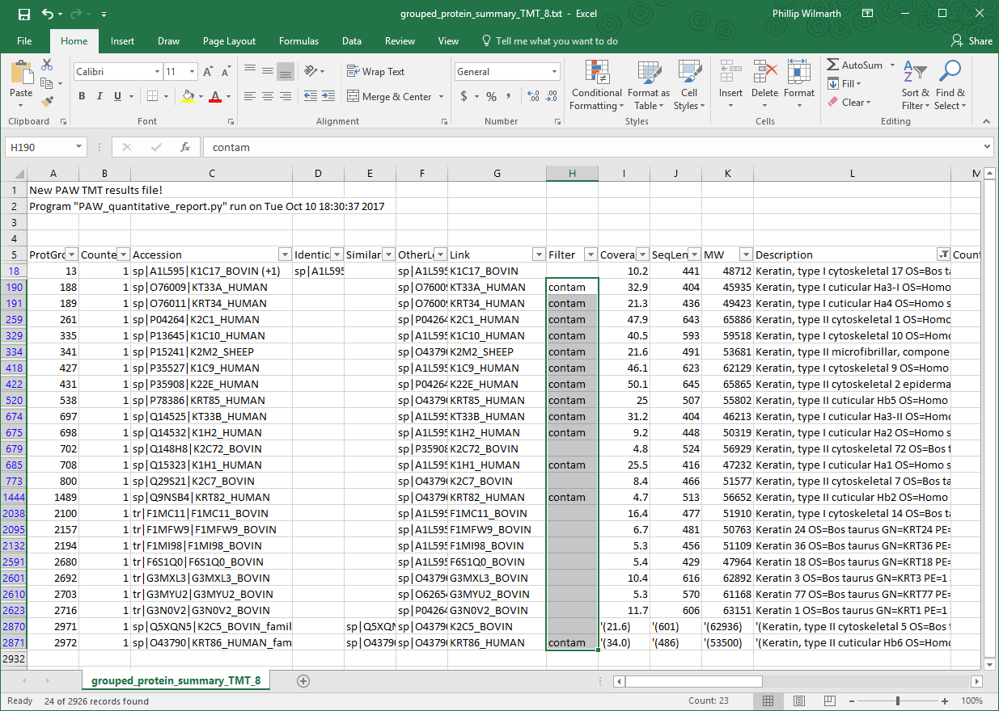
We get some of the previous keratin contaminants and several new keratins.
We want to flag them all as “contam”.

Slide 41
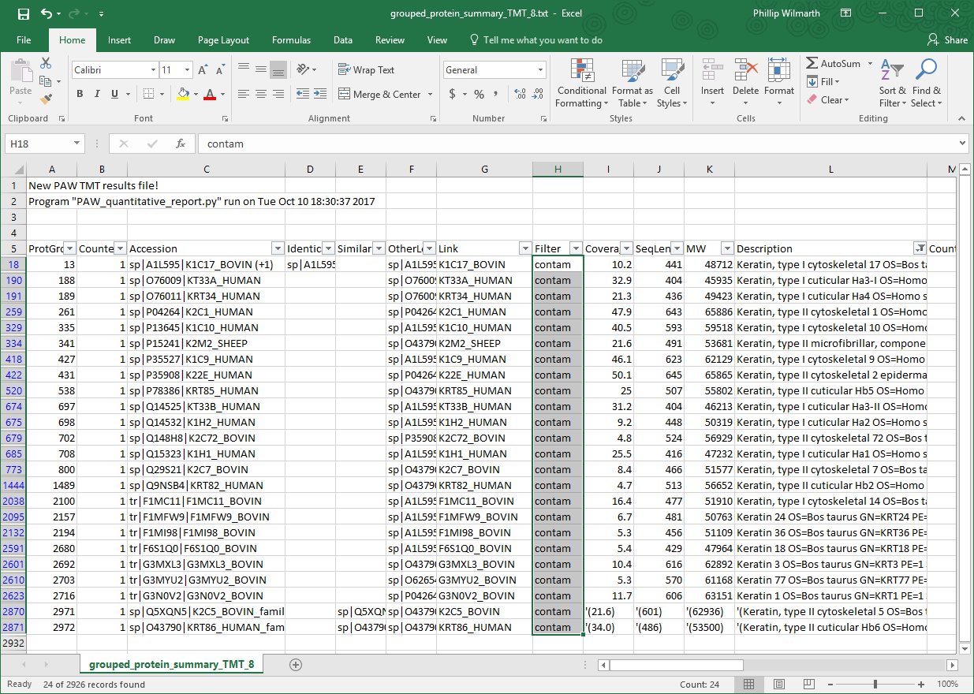

Slide 42
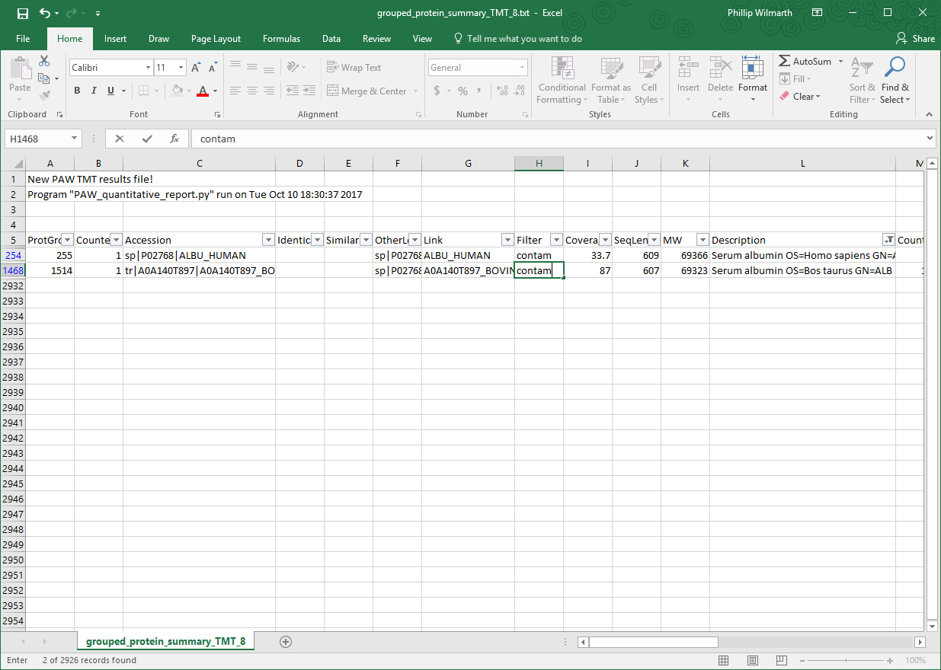
We do the same thing for any protein descriptions containing “albumin”. We find them using the Description column filter and then flag them as “contam” in the Filter column.
Notes: Albumin is a valid protein in serum/plasma, CSF, saliva, etc. All non-contaminant proteins need to have nothing in their cells in the Filter column. Any proteins with any text in the Filter column will be excluded.

Slide 43
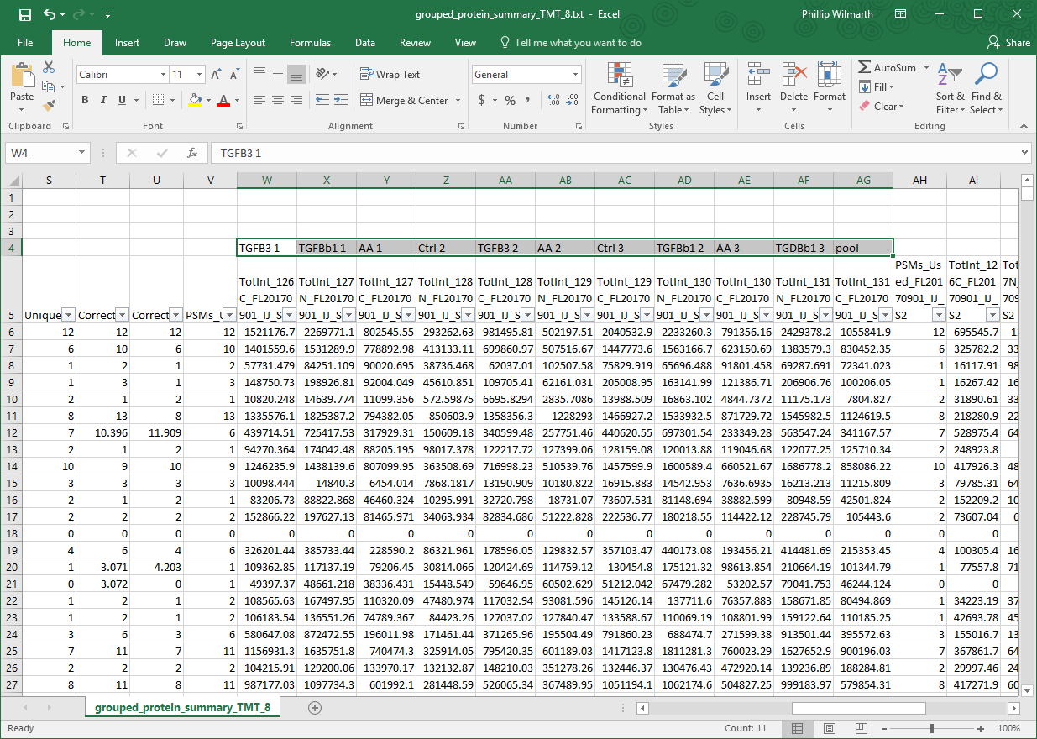
Next, add a reporter ion sample key above the respective channels in each TMT experiment. Good notes about what TMT reagent was used to label each biological sample are critical. The sample designations need to be in Row 4 aligned with the channel that they correspond to. The common internal channels need to contain “pool” within the Row 4 text string (it is not case sensitive). Do not use “pool” in any other sample names. Do not duplicate sample names within the same TMT experiment (e.g., use Pool1 and Pool2 when 2 pools are used).

Slide 44
Important note about TMT reagent order in results files:
Data exported from Proteome Discoverer arranges the TMT columns in increasing mass order of the reagents. That order is maintained by the scripts. That means that ”N” forms come before “C” forms. This is backwards from how an alphabetical sort would order them. If you want to make a sample key and then sort it into the same order as columns in the results files, use label names such as “127_N” and “127C”. The underscore character will sort ahead of the “C” character (“.” or “-” are also good choices).

Slide 45
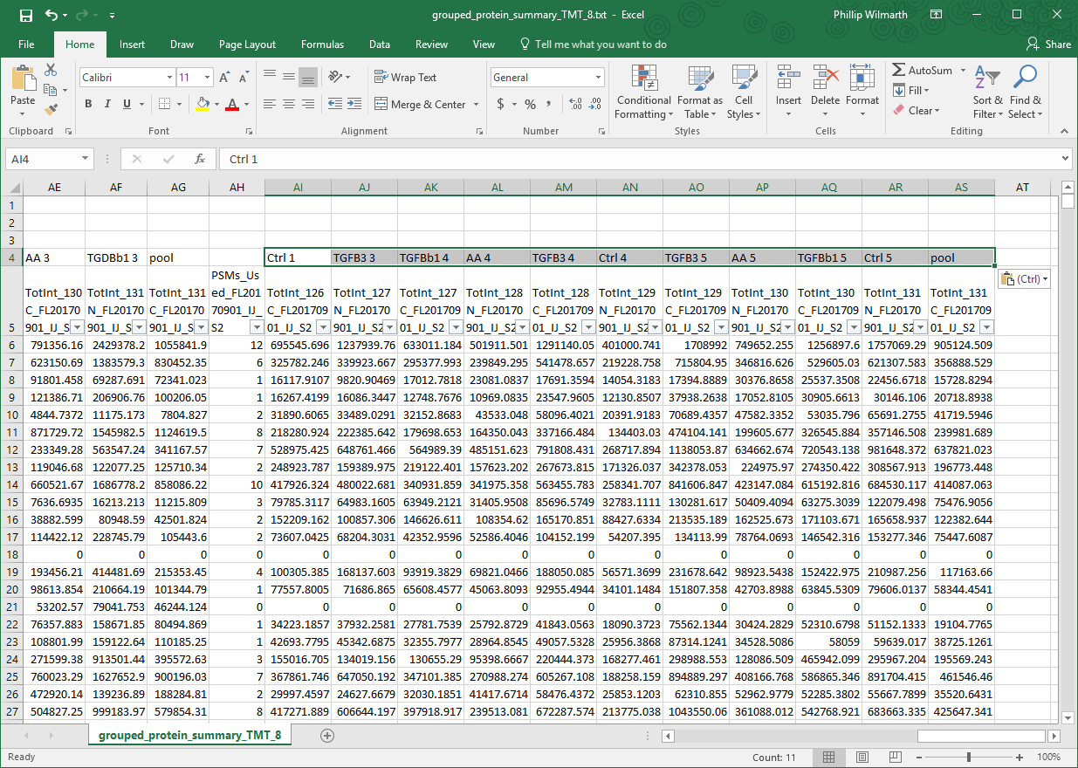
Add the sample designations for all other channels in all other TMT experiments being combined.
Note: this final script does both sample loading corrections and IRS corrections. It does not do just sample loading corrections for single TMT labeling experiments.

Slide 46
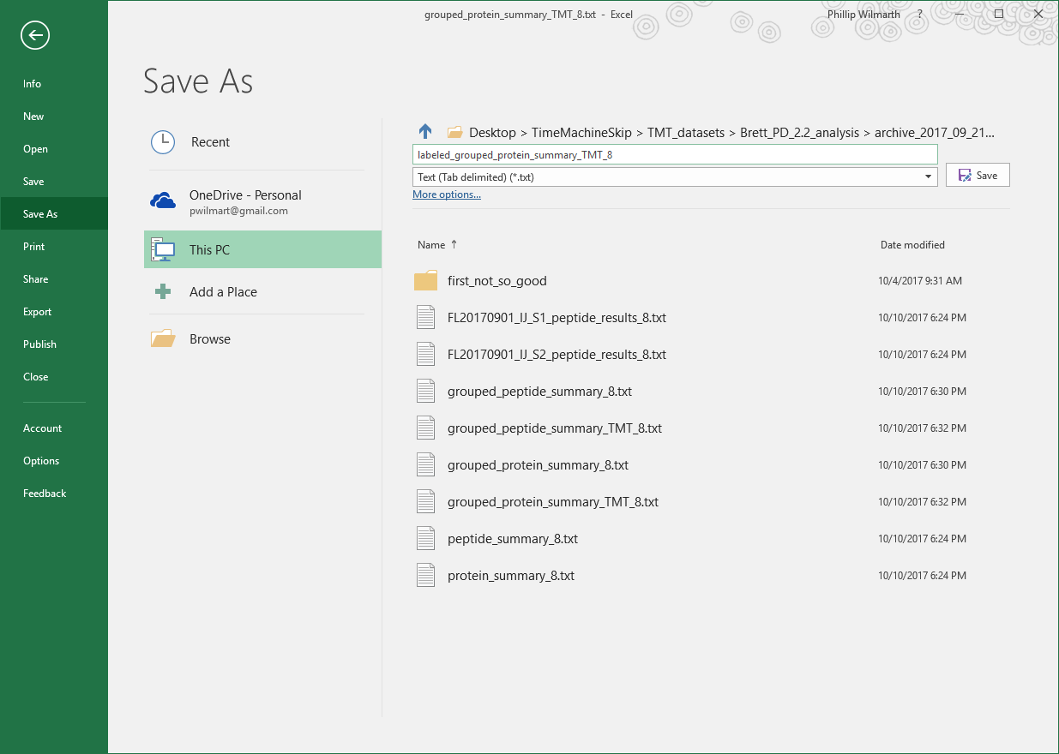
After contaminants have been flagged and the reporter ion channels have had the biological sample designations added in Row 4, we will “Save As” the text file in tab-delimited text format. Add something to the filename to indicated that samples have been labeled, and save the file. Excel may alarm you with warnings. You can ignore them. Excel may ask you if you want to save the file after you have already saved it when you Quit Excel. That can be ignored, too.

Slide 47
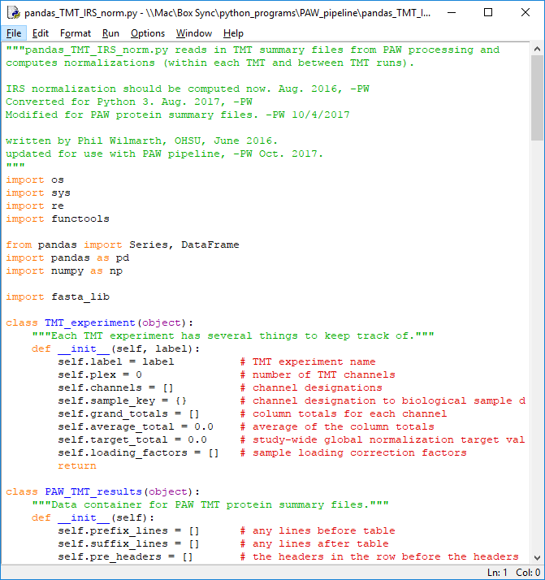
We are finally at the final pipeline step. This script uses the pandas package to perform many Excel-like data manipulations of the tabular data: contaminant proteins are moved to the bottom of the table, sample loading corrections are done within each TMT experiment, proteins not seen in all TMT experiments are excluded, pooled standards within each TMT experiment are averaged, IRS factors are computed, and IRS normalized intensities are computed.

Slide 48
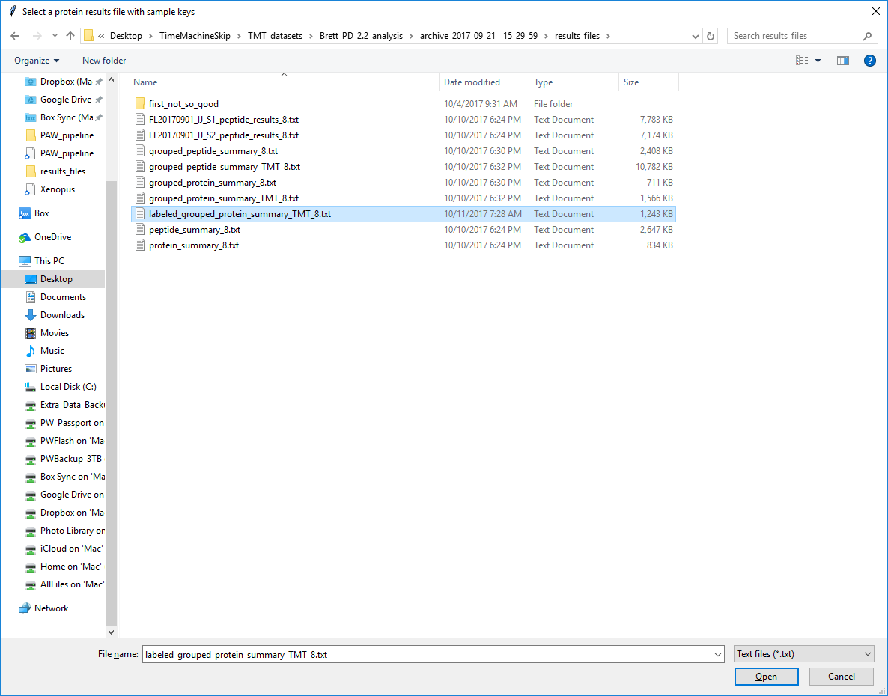
1
2

Slide 49
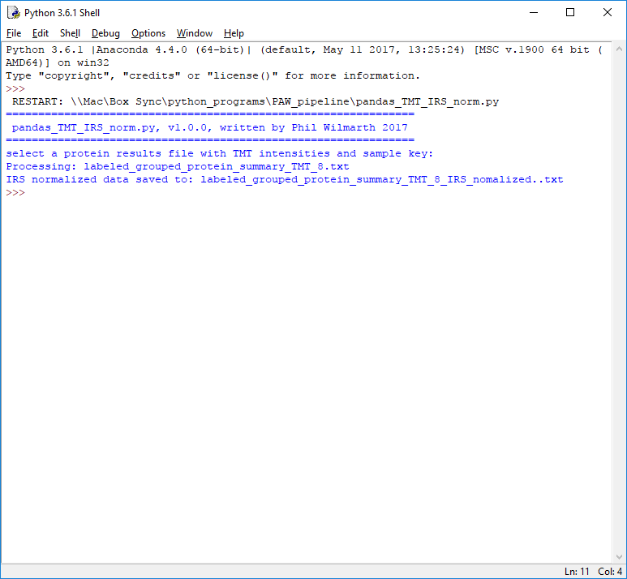
There is minimal console output. The tab-delimited text file now contains properly normalized total protein intensities for all non-contaminant proteins that were seen in all TMT labelings.
This final data can be used in statistical testing software like the Bioconductor R package edgeR.

Slide 50
Updating Anaconda (bonus material)

Slide 51
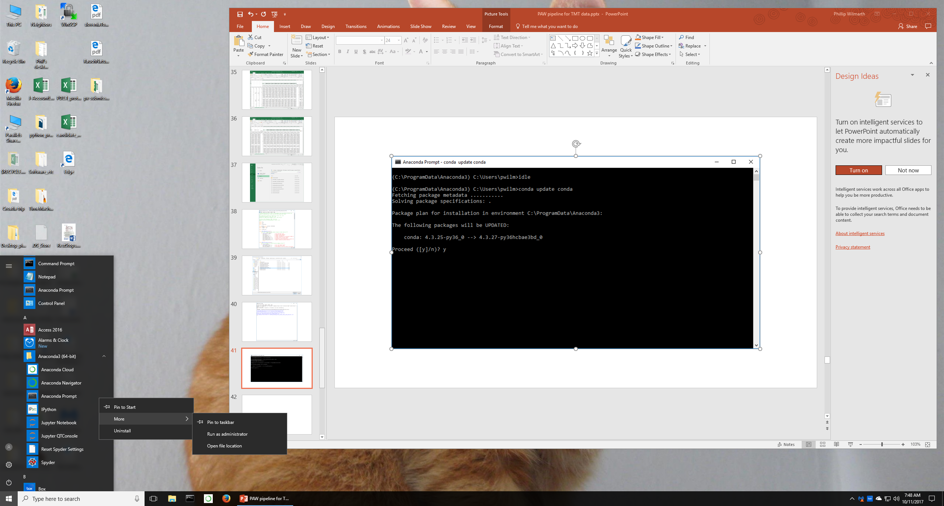
The Anaconda python distribution requires periodic package updates. It includes a convenient package manager called “conda”. You will want to run the Anaconda Prompt as an admistrator.
Right clicks get the extra program launch options.

Slide 52
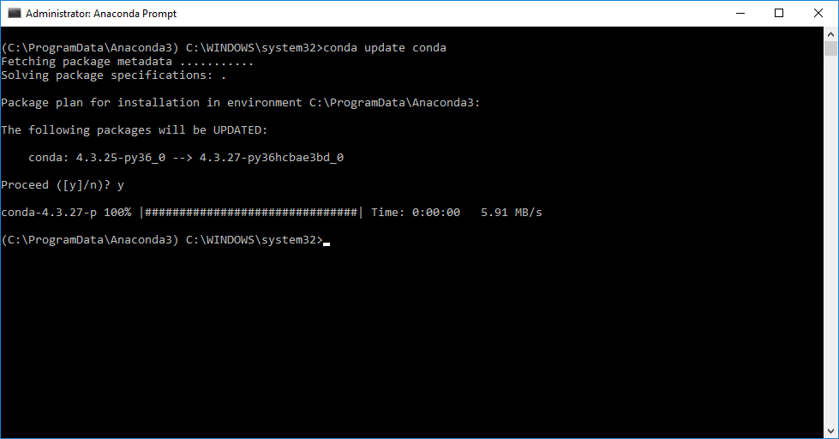
Update conda first with the “conda update conda” command

Slide 53
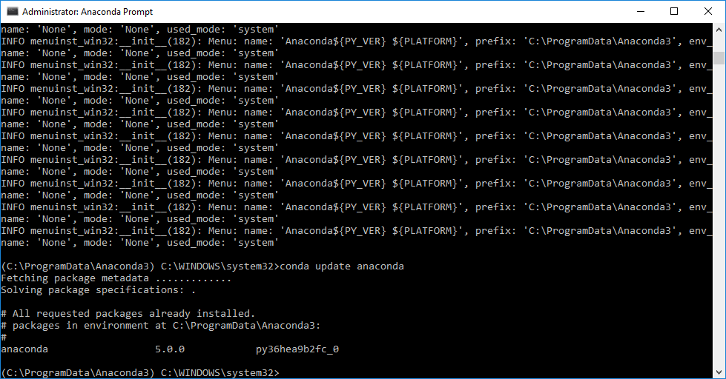
Update anaconda next with the “conda update anaconda” command. There might not be any needed updates depending on the preceeding conda update step.

